Slide 1
MODES OF E-PAYMENT
Welcome
Presented By:
Kanchan
Udit
Bhushan
Devendra

Slide 2
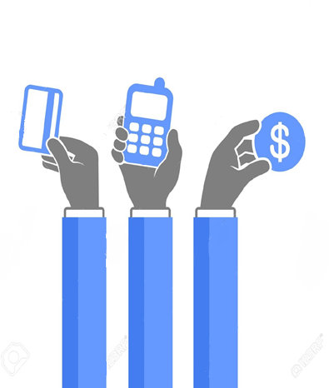
What is E-Payment?
Why E-Payment is needed?

Slide 3
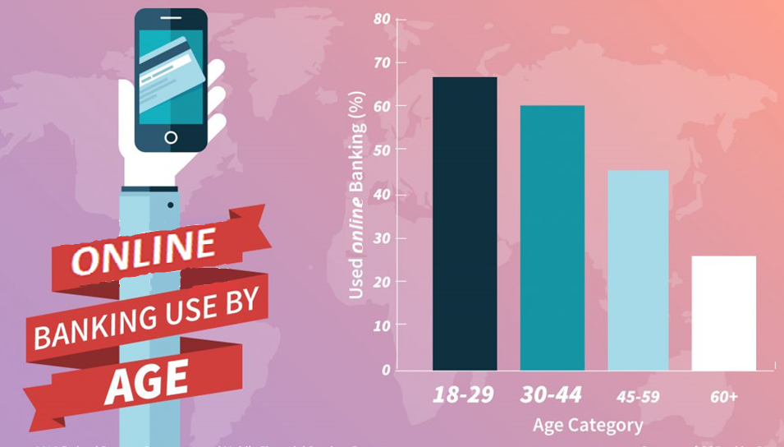

Slide 4

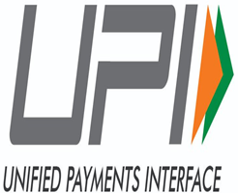
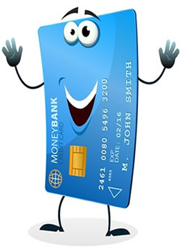
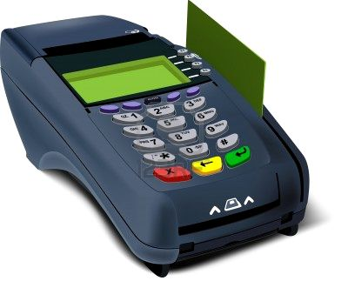
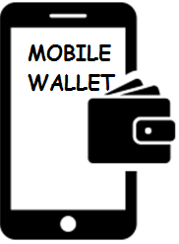

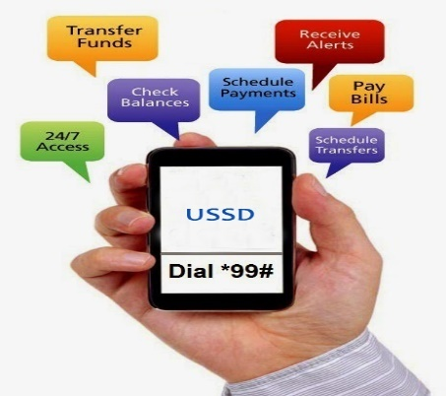

Modes of E-Payments
Cards
AEPS
POS
USSD

Slide 5
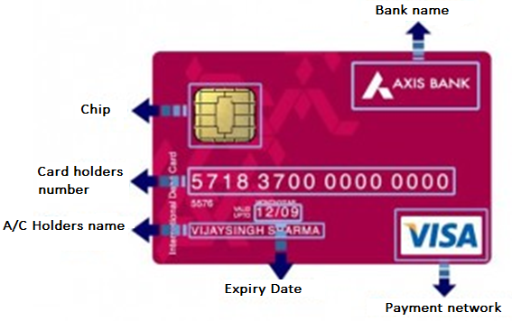
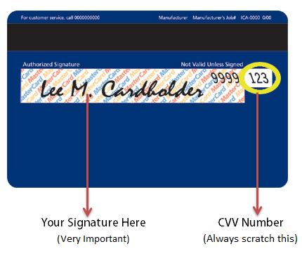
Debit Card
What is debit card?
Benefits
Uses

Slide 6
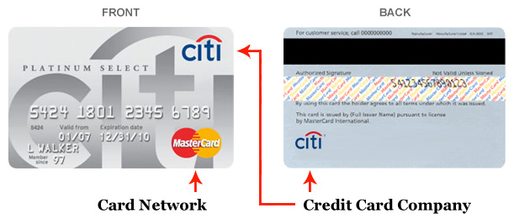
Credit card
What is Credit Card?
Who is eligible?
Benefits to the customers

Slide 7
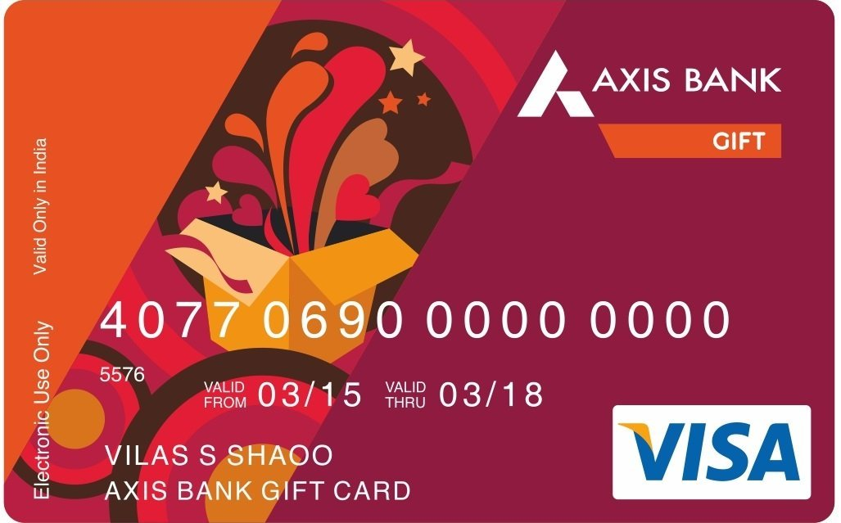
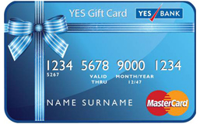
Pre-Paid & Gift Cards
Reloadable Card
Rebate
When a Pre-paid/Gift card can be use?

Slide 8
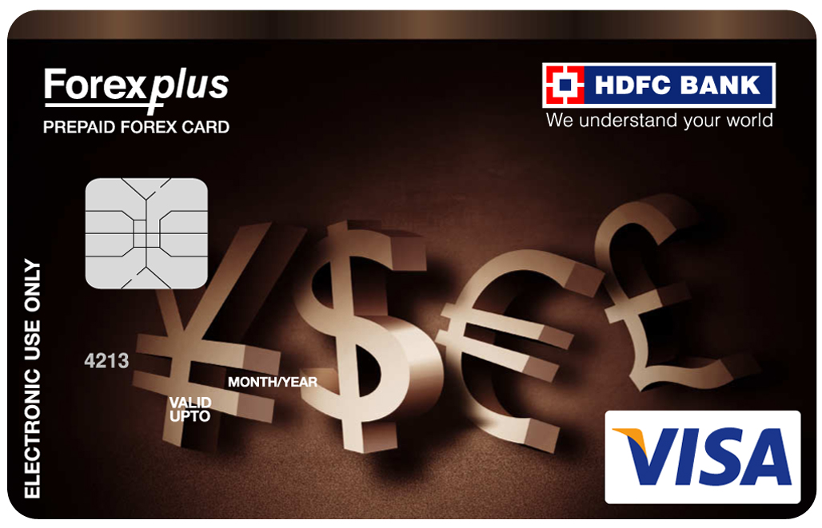
Travelers Card
What is T-Card?
Uses of T-Card
Where to use T-Card?
Why use the T-Card?

Slide 9
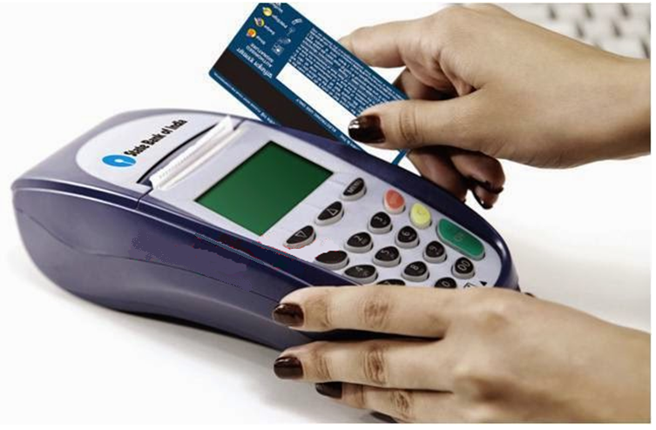
Point Of Sale
What is POS?
Where we use it?
Benefits of POS

Slide 10
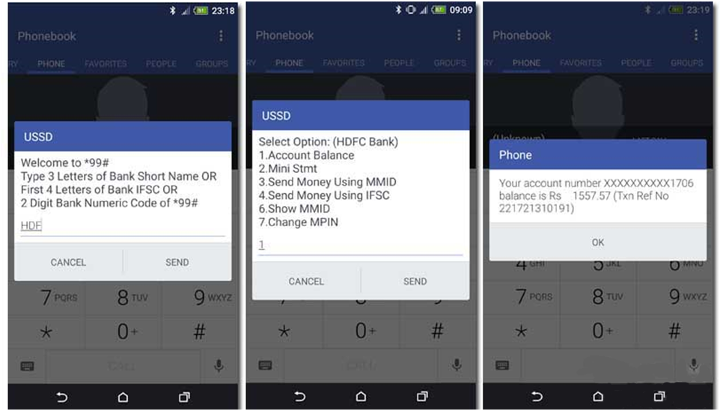
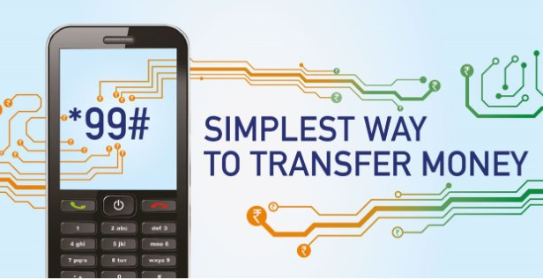
USSD
Bank without internet
How to use USSD?
*99#
We can use it on any mobile.

Slide 11
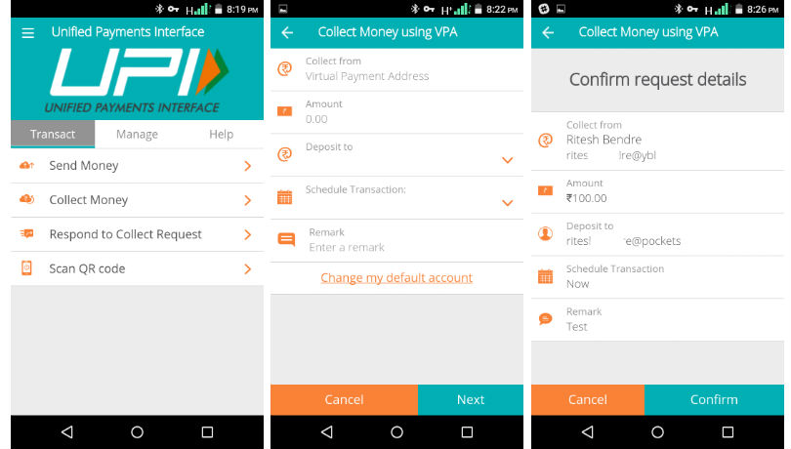
UPI
It is a interface which serves three goals of RBI
Unified electronic payment
Less cash Society
Financial Inclusion
Interoperable

Slide 12
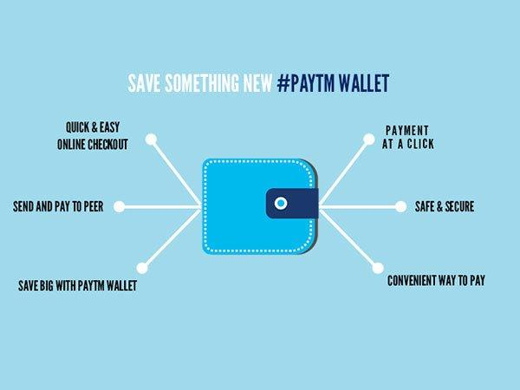




Mobile wallet
What is Mobile Wallet?
How to use?
Virtual Wallet
Examples

Slide 13
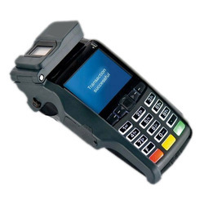
Micro ATMs
What is Micro-ATM?
Functions
How do they work?

Slide 14
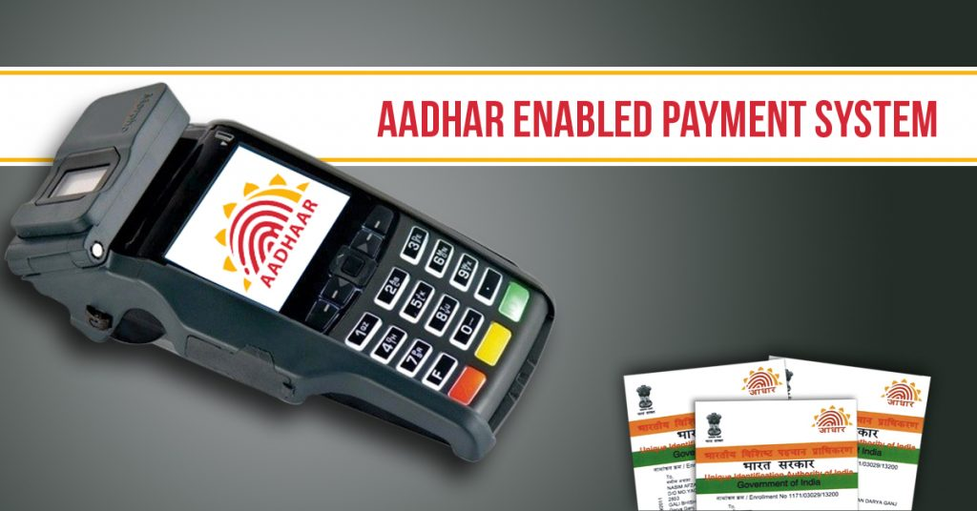

AEPS
Aadhaar Number must be link with your Bank a/c
No need to carry passbook/chaque book/cards
No password
Only

Slide 15

Internet banking
What is Internet Banking?
Services
Issues in Internet Banking

Slide 16
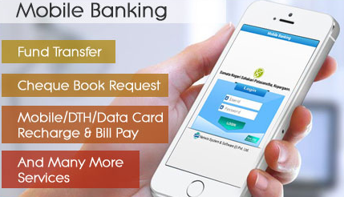
Mobile Banking
Bank in your pocket
services
Why Bank promote mobile banking?
Growth

Slide 17
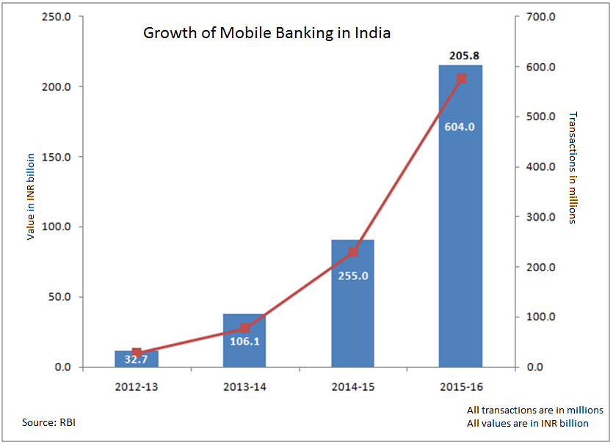

Slide 18


Advantages
E-payment is simple and easy to operate.
Time savings
Expenses control
Low commissions
Easily Traceable

Slide 19

Disadvantages
Restrictions
The risk of being hacked
The lack of anonymity
The necessity of Internet access

Slide 20
Conclusion
Override traditional payment system into digital payment system.
Made human life convenient.
Now a person can choose anything from a wide range of payment options.

Slide 21

THANK YOU

